Slide 1
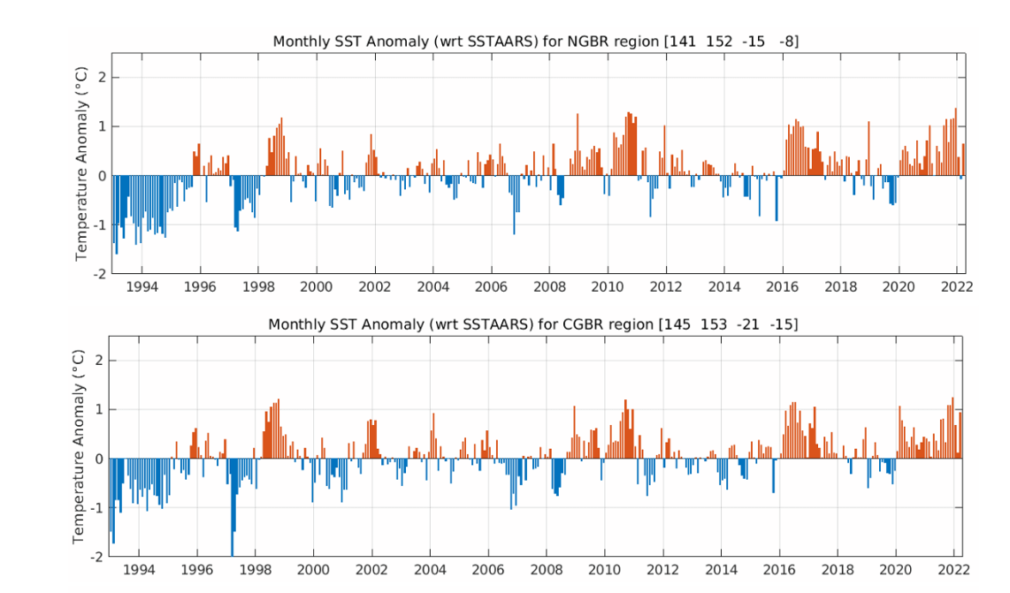
Time Series Analysis

Slide 2
Introduction to Time Series
Regression vs. Time Series Analysis
Examples of Time Series Data
Components of Time Series: Trend, Seasonality, Noise, and Stationarity
Key Takeaways
Agenda

Slide 3
Definition: A time series is a sequence of data points collected or recorded at specific time intervals.
Purpose: Used to analyze how a variable changes over time.
Applications: Common in finance, economics, weather forecasting, and morential library for anyone working with data in Python.
Introduction to Time Series

Slide 4
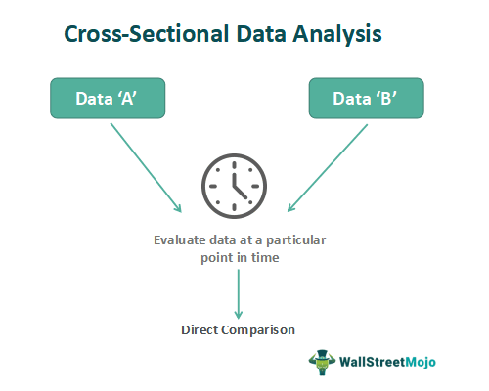

Slide 5
Regression vs. Time Series Analysis
Time Series Analysis:
Focuses on a single variable over time.
Assumes data dependency on time with autocorrelation.
Regression Analysis:
Examines relationships between multiple variables.
Assumes data independence without multicollinearity.

Slide 6
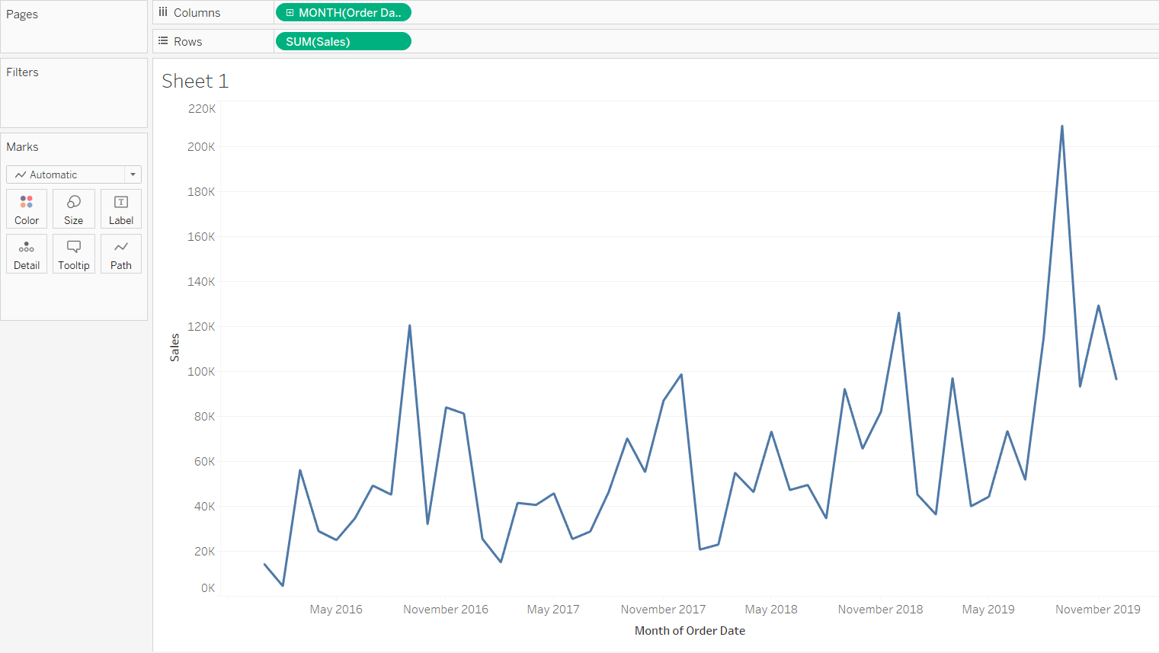
Examples of Time Series Data
Weather data
Rainfall measurements
Temperature readings
Heart rate monitoring (EKG)
Brain monitoring (EEG)
Quarterly sales
Stock prices
Automated stock trading
Industry forecasts
Interest rates

Slide 7
Components of Time Series Data:
Trend: Long-term movement in the data.
Seasonality: Regular pattern repeating over a specific period.
Noise: Random variations not explained by the model.
Stationarity: Statistical properties that do not change over time

Slide 8
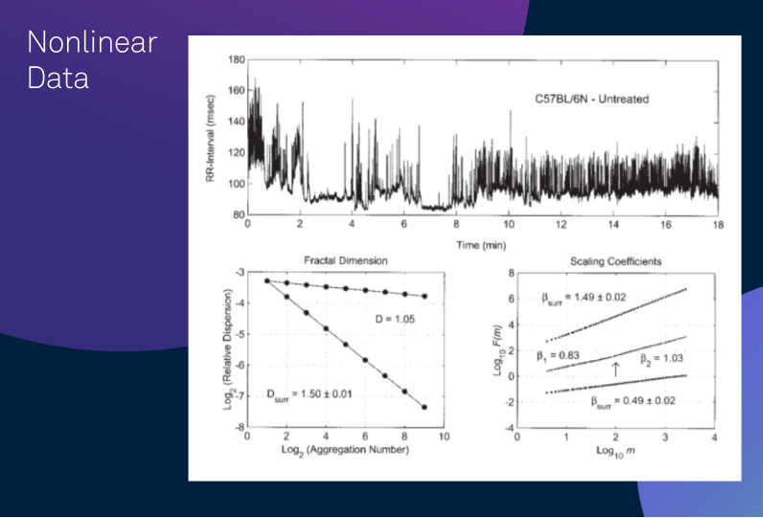
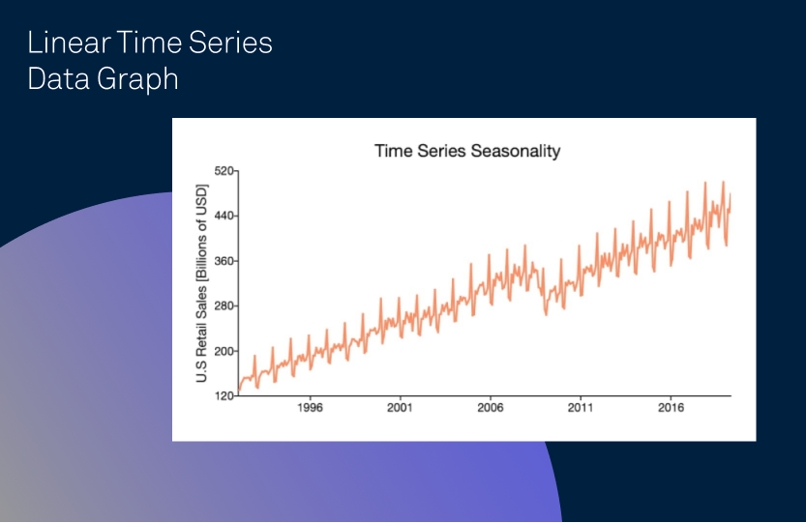
Analyzing Trends
Definition: Trends represent long-term direction in the data.
Example: Increasing sales over several years.

Slide 9
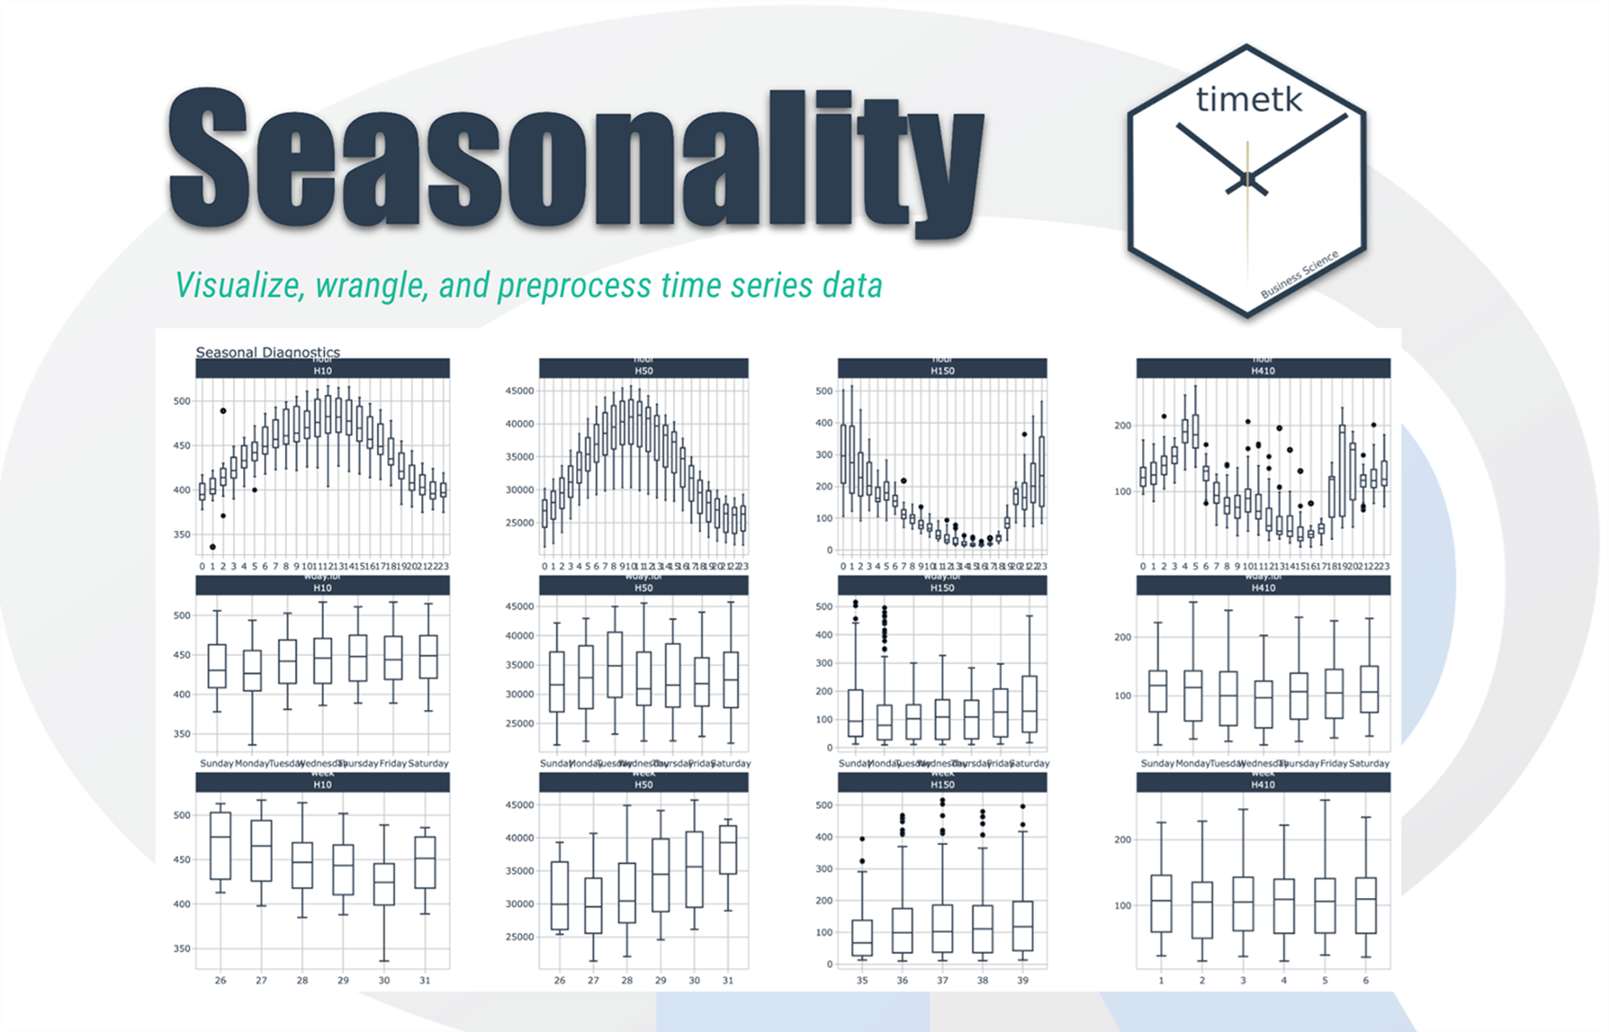

Slide 10
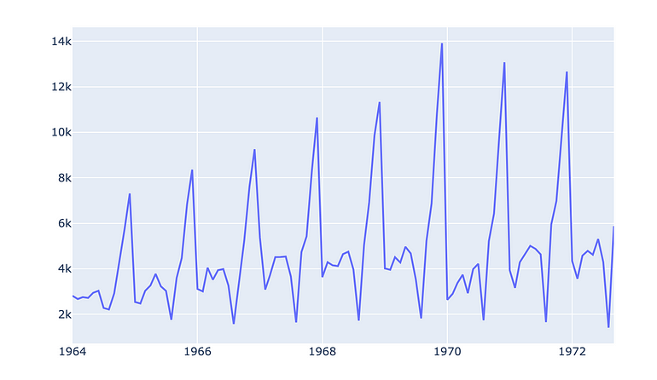
Understanding Seasonality
Definition: Patterns that repeat at regular intervals (e.g., monthly, quarterly).
Example: Increased retail sales during holiday seasons

Slide 11
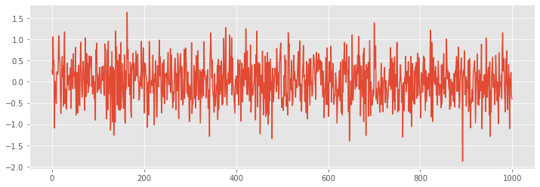
Identifying Noise
Definition: Random variations or irregularities in the data after accounting for trend and seasonality.
Example: Daily fluctuations in stock prices unrelated to trends or cycles

Slide 12
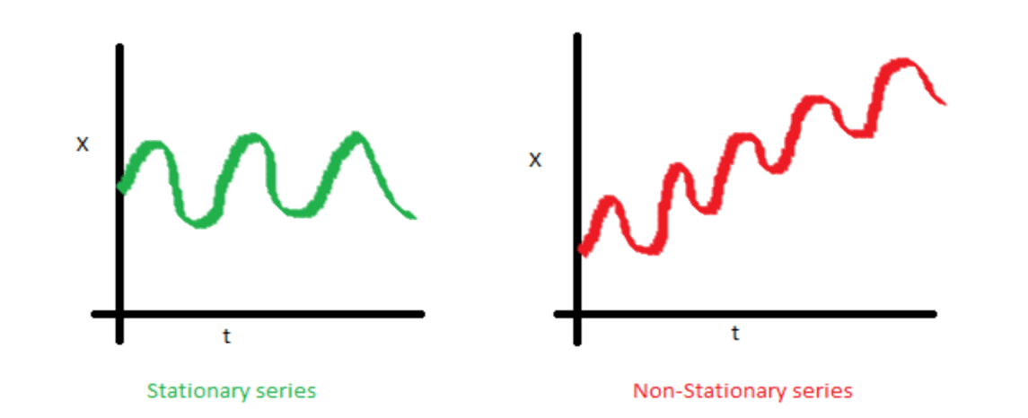

Stationarity in Time Series
Definition: A stationary time series has constant mean and variance over time.
Importance: Many time series models assume stationarity for accurate forecasting.

Slide 13
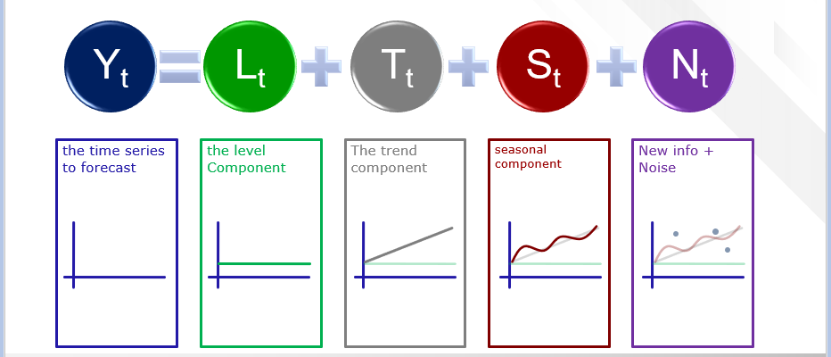

Slide 14
1st part of Time Series Ends…
Thanks

